Slide 1
Proposals
Chapter 10

Slide 2
Proposals
Proposals are written offers to solve problems, provide services, or sell equipment.
An RFP is a request for proposal.

Slide 3
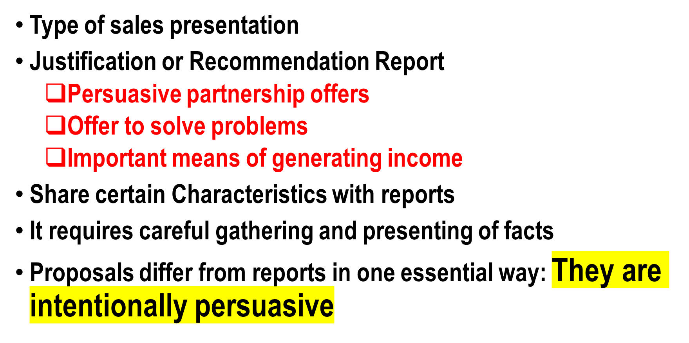
Proposals

Slide 4
Proposals
Proposal writers do not just provide information in orderly, useful way, they write to get a particular result.
They have vested interest in the result.
The purpose of proposals can be acquiring a major client, getting a new equipment etc.
They can vary widely in purpose, length and format

Slide 5
Proposals
They can range from one page to hundreds of pages
All proposals can be categorized either internal or external, solicited or unsolicited
Proposals must do an effective job of presenting a complete picture of what is being proposed.
You must work hard to meet reader’s needs so readers can make decision in your favour.

Slide 6
Informal Proposals
THEY ARE SALES PRESENTATIONS
Just Like Formal Proposals, Informal Proposals are written offers to:
    Solve Problems
    Provide Service
    Sell Equipment
Differ from formal proposals in length and format
May be presented in short (2 to 4 page) letters.
Sometimes also called Letter Proposals.

Slide 7
Kinds of Proposals
Formal
  Long (Can be consisted on 100 pages)
Informal
  Short (Not more than 2 or 4 Pages)
  Pattern of formal proposal would be followed in case of more than 4 pages.

Slide 8
Formal Proposals
Title Page
Copy Of RFP
Letter of Transmittal
Abstract or Summary
Table of Contents
List of Figures
Introduction
Background Information (Problem, Purpose)
Proposal, Plan, Schedule
Staffing Requirements
Budget
Authorization Request
Appendix

Slide 9
Informal Proposals
Introduction
Background Information (Problem, Purpose)
Proposal, Plan, Schedule
Staffing Requirements
Budget
Authorization Request

Slide 10
Preface
Indicates where, in what period, and in which connection the work has been performed.
Write here, if the report is aimed at a special group of readers, and thank the people that have helped.

Slide 11
Preface: Example
This report has been written in May 2000 in a four–week project at the IT University of Copenhagen under the supervision of . . . . We thank John Doe for assistance with the program for handling TIFF–images. During the project, we developed a Java–program for analysis of microscope images of lactic acid bacteria. The program analyses a TIFF file that is produced by a digital camera that in turn is connected to a microscope. It finds the contours of all bacteria above a certain size in the image, and prints these contours to a file in REG format.

Slide 12
1. Introduction
You need to provide a HOOK to capture the interest of reader. Follow these points:
Promise low cost or speedy result.
Mention a remarkable resource available exclusively to customer
Identify a serious problem
Specify a key issue or benefit.

Slide 13
1. Introduction
For example, in the introduction of the proposal shown in Figure 10.1 (Page 256), Allen Ward focused on what the customer was looking for. He analyzed the request of the Cambridge dentist, Dr. Diane Corbett, and decided that he was most interested in specific recommendations for improving service to her patients.

Slide 14
1. Introduction: Example
Understanding the Views Of your patients is the key to meeting their needs. Approach Market Research is pleased to propose a plan to help you become even more successful by learning what patients expect of your practice, so that you can improve your services.

Slide 15
1. Introduction: Example
The world is becoming advanced because of the many technological advancements in the computing science domain. However, the security concerns related networks is one of the biggest challenges. Harry Porter Security offers valuable plans for these issues.

Slide 16
1. Introduction: Example
Soft skills play a vital role in the life of a professional as an individual has to present many plans to the clients, persuade the customers to buy your product etc. By keeping this important factor in mind, Training Monsters offers the training & development sessions for professionals.

Slide 17
2. Background, Problem and Purpose
Identify the problem.
Discuss the goal & purpose of proposal.
Convince the reader in both solicited & unsolicited proposal.
As RFP (Request for Proposal) , explain with the sub headings.

Slide 18
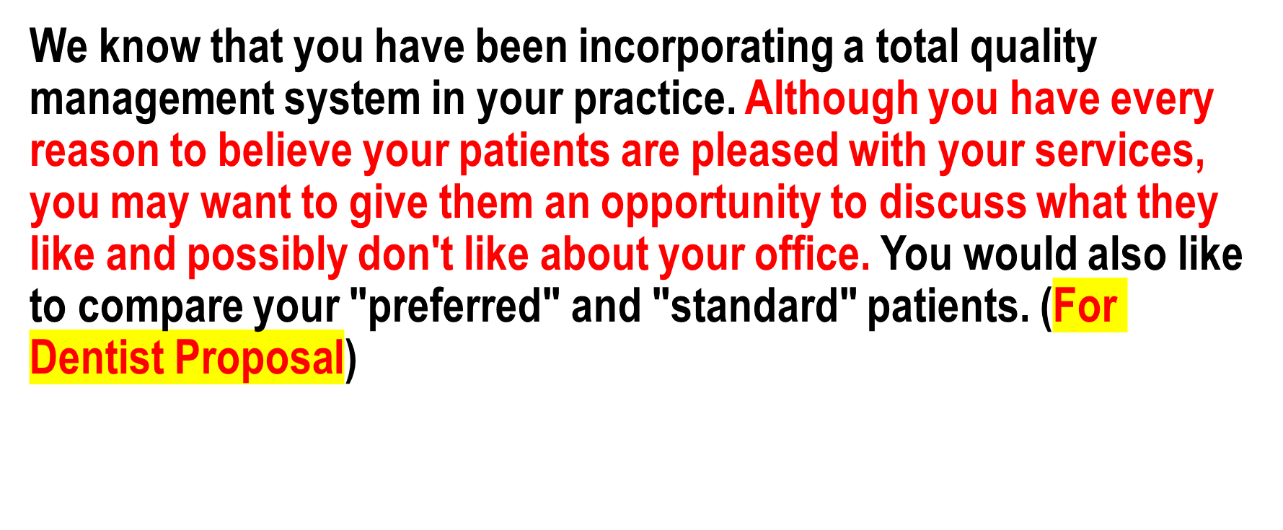
2. Example :

Slide 19
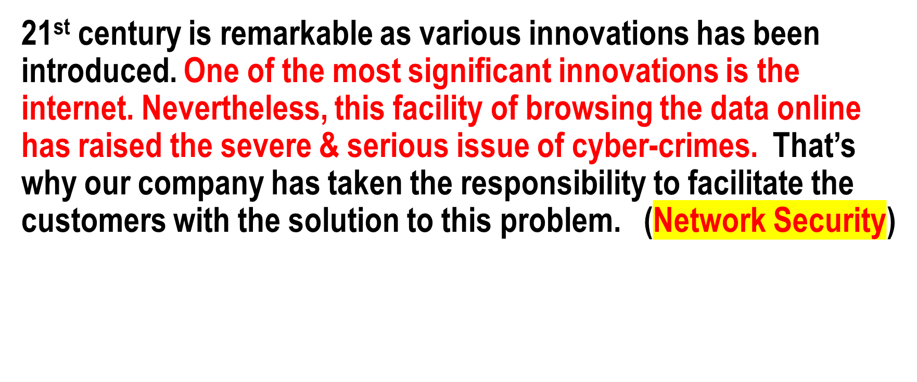
2. Example :

Slide 20
2. Example :
Training Monsters believe that a professional becomes more valuable when he knows how to deal nicely in a professional environment. Therefore, we started this company back in 2017 to train the professionals according to the need of the organization.

Slide 21
3. Proposal, Plan, & Schedule
Discuss plan to solve problem. Follow these points:
  Provide specific facts to solve problems.
  Specify how project will be managed.
  Specify audit mechanisms in place for the project.
  Specify a schedule of activities of events.
  Sell your method, product, and deliverables.

Slide 22
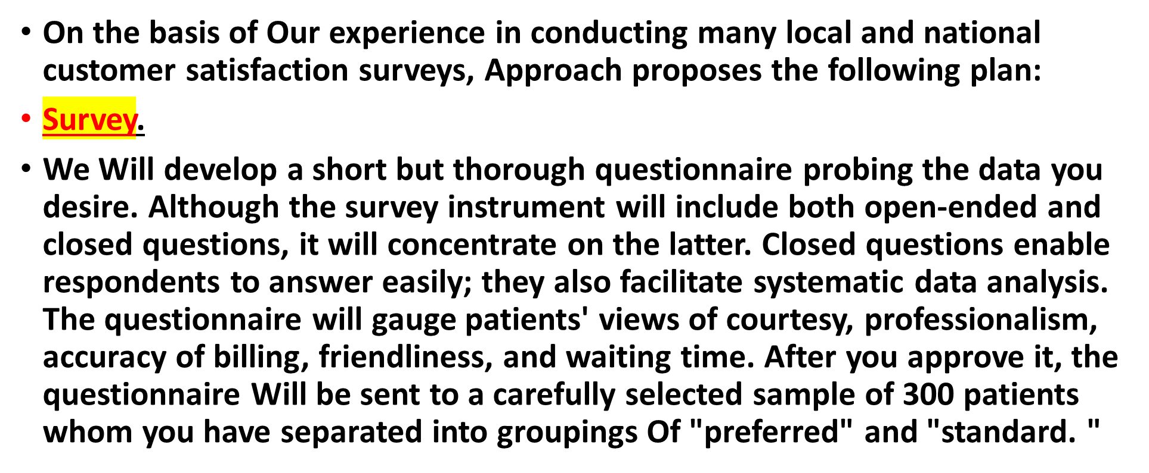
3. Example

Slide 23
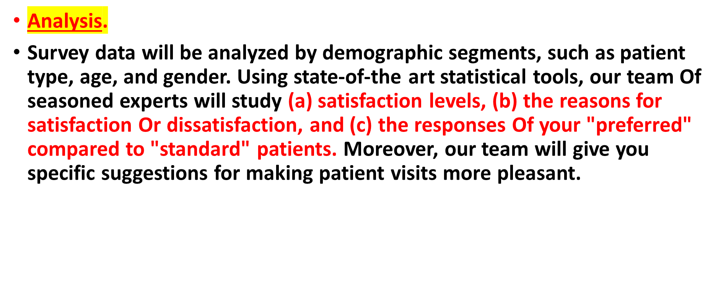
3. Example

Slide 24
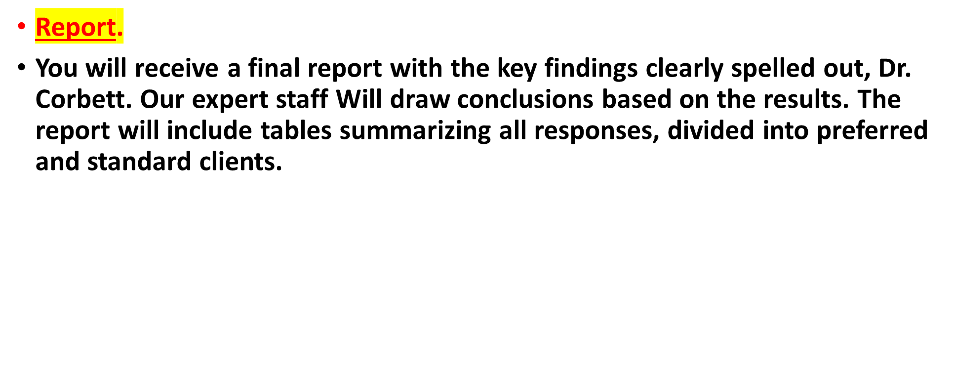
3. Example

Slide 25
3. Example
Schedule. With your approval, the following schedule has been arranged for your patient satisfaction survey:
Questionnaire development and mailing: August 1—6
Deadline for returning questionnaire: August 24
Data tabulation and processing: August 24-26
Completion of final report: September I

Slide 26
4. Staffing
Build credibility by describing outstanding staff and facilities.
Describe expertise of staff.
List size & qualification of staff.
  Keep information generic in case staff might be changed after proposal submission.
List other resources available such as computer facilities.

Slide 27
4. Staffing
Approach is a nationally recognized, experienced research consulting firm specializing in survey investigation. I have assigned pour customer satisfaction survey to Dr. Scott Wu, our director of research. Dr. Wu was trained at Boston University and has successfully supervised our research program for the past nine years. Before joining Approach, he was a marketing analyst with T-Mobile.

Slide 28
4. Staffing
Assisting Dr. Wu Will be a team headed by Karen Ploeger, our Vice president for operations.
Ms. Ploeger earned a BS in computer science and an MA degree in marketing from the University Of Karachi.
She supervises our computer-aided telephone interviewing (CAT) system and manages our 30-person professional interviewing staff.

Slide 29
5. Budget
Must be described as proposals are legal contracts.
List total cost or itemized cost of the project.

Slide 30
5. Budget
 | Estimated Hours | Rate | Total
Professional and administrative time
Questionnaire development | 03 | 150$ / hr | 450$
Questionnaire mailing | 04 | 40$/hr | 160$
Data processing and tabulation | 02 | 40$/hr | 80$
Analysis of findings | 15 | 150$/hr | 2250$
Preparation Of final report | 05 | 150/hr | 750$
Mailing costs: 300 copies Of questionnaire |  |  | 120$
Postage and envelopes |  |  | 270$
Total Cost |  |  | $4480

Slide 31
6. Authorization
At the end, include the request for the Authorization.
Remind reader of key benefit or motivate for action.
Set a deadline date for the invalidation (cancellation) of the proposal.

Slide 32
6. Authorization
We are convinced, Dr. Corbett. that our professionally designed and administered patient satisfaction survey will enhance your practice. Approach Market Research can have specific results for you by September I if you sign the enclosed duplicate copy Of this letter and return it to us With a retainer Of $2,300 so that we may begin developing your survey immediately. The rates in this offer are in effect only until October l.

